Slide 1
Weed
Classification using VGG16
Deep Learning project

Slide 2
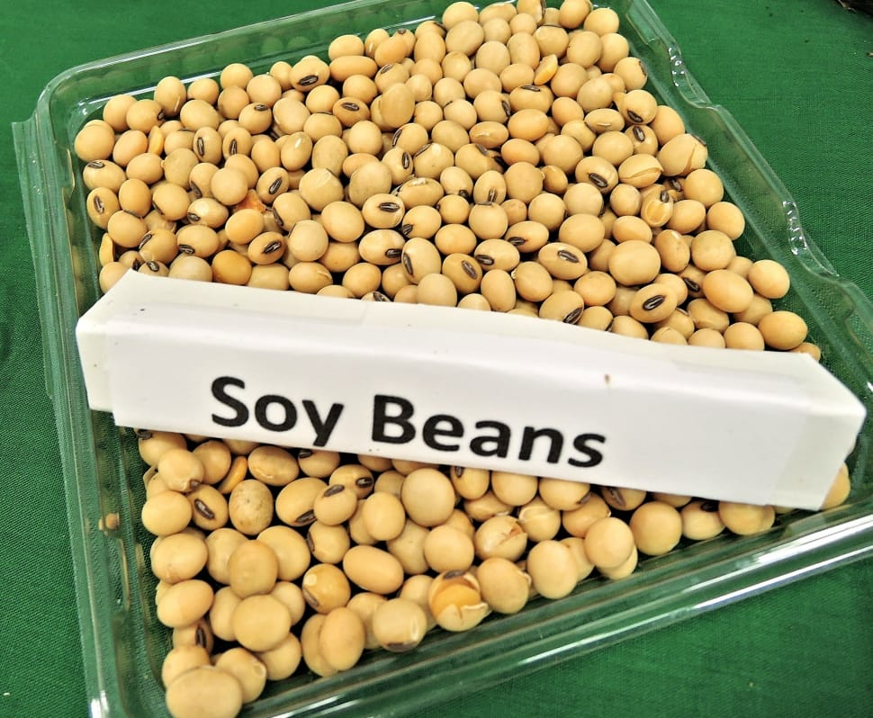
Aim
The aim is to use deep learning techniques to increase the accuracy of weed detection and decrease farmer’s workload. Classification of soybean crops and weeds (broadleaf, soil, grass) is done by using VGG16 Transfer learning approach.

Slide 3


1. Intro
From the set of images captured by the UAV, all those with occurrence of weeds were selected resulting a total of 400 images. Through the Pynovisão software, using the SLIC algorithm, these images were segmented and the segments annotated manually with their respective class. These segments were used in the construction of the image dataset.
Data source https://data.mendeley.com/datasets/3fmjm7ncc6/2
Dataset This image dataset has 15336 segments, being 3249 of soil, 7376 of soybean, 3520 grass and 1191 of broadleaf weeds

Slide 4
Importing prerequisite modules
import numpy as np #For array manipulations in Python.
import matplotlib.pyplot as plt #for data visualization.
import seaborn as sns #statistical data visualization
import os #accessing files and directories.
import cv2 #for image processing tasks.
import io # for input/output operations.
from tqdm import tqdm #for creating progress bars to track the progress of tasks.
import glob #to retrieve files/pathnames that match a specified pattern.
import tensorflow as tf #open-source framework for deep learning
import random #for generating random numbers
from google.colab import drive #for accessing files in Google Drive
from sklearn.model_selection import train_test_split #to split data into training and testing subsets.
from tensorflow.keras.utils import to_categorical #for one-hot encoding categorical labels.

Slide 5
Access data from Google Drive
drive.mount('/content/drive’)
folder_path = '/content/drive/MyDrive/dataset'
files = os.listdir(folder_path)
for file in files:
print(file)
grass
soybean
soil
broadleaf

Slide 6
Defining and Initializing prerequisites
# Define class labels
class_labels = ['grass','soybean', 'soil', 'broadleaf’]
# Initialize lists to store images (X) and labels (Y)
X = []
Y = []

Slide 7
Loading and Preprocessing Images
# Iterate over the class folders
for label_idx, label in enumerate(class_labels):
class_folder_path = os.path.join(folder_path, label)
# Iterate over the images in the class folder
for image_file in os.listdir(class_folder_path):
image_path = os.path.join(class_folder_path, image_file)
# Read the image
image = cv2.imread(image_path)
# Resize the image to a consistent size
resized_image = cv2.resize(image, (227, 227)) # Adjust dimensions
# Append the resized image to the X list
X.append(resized_image)
# Append the corresponding label to the Y list
Y.append(label_idx) # Use the index of the class label as the label value

Slide 8
Data Conversion and One-Hot Encoding
# Convert the lists to NumPy arrays
X = np.array(X)
Y = np.array(Y)
# Perform one-hot encoding on the labels
Y = to_categorical(Y, num_classes=len(class_labels))
# Print the shapes of the image data (X) and label data (Y)
print('X shape:', X.shape)
print('Y shape:', Y.shape)
X shape: (15386, 227, 227, 3)
Y shape: (15386, 4)

Slide 9
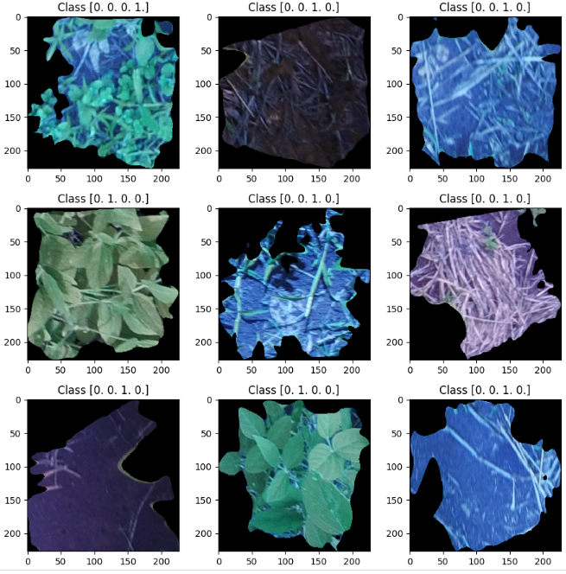
Visualization of Random Image Samples with Class Labels
plt.rcParams['figure.figsize'] = (9,9) # Make the figures a bit bigger
for i in range(9):
plt.subplot(3,3,i+1)
num = random.randint(0, len(X))
plt.imshow(X[num], cmap='gray', interpolation='none')
plt.title("Class {}".format(Y[num]))
plt.tight_layout()

Slide 10
Data Splitting into Training, Validation, and Test Sets
# Split into training and temporary sets
X_train_temp, X_test, Y_train_temp, Y_test = train_test_split(X, Y, test_size=0.2, random_state=42)
# Split temporary data into training and validation sets
X_train, X_val, Y_train, Y_val = train_test_split(X_train_temp, Y_train_temp, test_size=0.2, random_state=42)
# Print the shapes of the training, validation, and test sets
print('X_train shape:', X_train.shape)
print('Y_train shape:', Y_train.shape)
print('X_val shape:', X_val.shape)
print('Y_val shape:', Y_val.shape)
print('X_test shape:', X_test.shape)
print('Y_test shape:', Y_test.shape)
X_train shape: (9846, 227, 227, 3)
Y_train shape: (9846, 4)
X_val shape: (2462, 227, 227, 3)
Y_val shape: (2462, 4)
X_test shape: (3078, 227, 227, 3)
Y_test shape: (3078, 4)

Slide 11
Importing VGG16 Transfer Learning Model
from tensorflow.keras.applications import VGG16
from tensorflow.keras.models import Model
from tensorflow.keras.layers import Dense, GlobalAveragePooling2D
# Load pre-trained VGG16 model
base_model = VGG16(weights='imagenet', include_top=False, input_shape=(227, 227, 3))
# Freeze the layers in the base model
for layer in base_model.layers:
layer.trainable = False

Slide 12
Adding Output Layers
# Add a new classification head
x = base_model.output
x = GlobalAveragePooling2D()(x)
x = Dense(256, activation='relu')(x)
predictions = Dense(4, activation='softmax')(x) # Output layer with 4 classes
# Create the transfer learning model
model = Model(inputs=base_model.input, outputs=predictions)
# Compile the model
model.compile(optimizer='adam', loss='categorical_crossentropy', metrics=['accuracy'])
# Print model summary
model.summary()

Slide 13
Transfer Learning
What is Transfer Learning?
Taking a pre-trained model and adapting it to a new, related task.
How to use Transfer Learning?
Fine-tuning the pre-trained VGG16 model by replacing or retraining the last few layers.
The pre-trained weights learned by VGG16 can be used as initial weights for the new task, saving time and computational resources.
Why Transfer Learning?
Benefits of VGG16 :
Achieving good performance with limited training data.
Leveraging the learned representations of VGG16 for feature extraction.
Speeding up the training process and reducing the need for extensive computational resources.

Slide 14
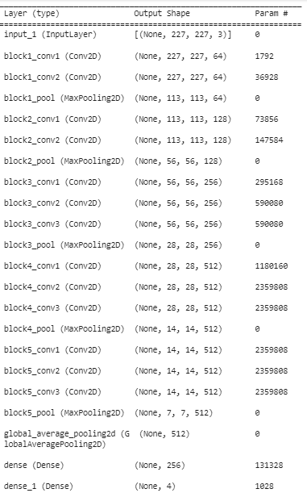
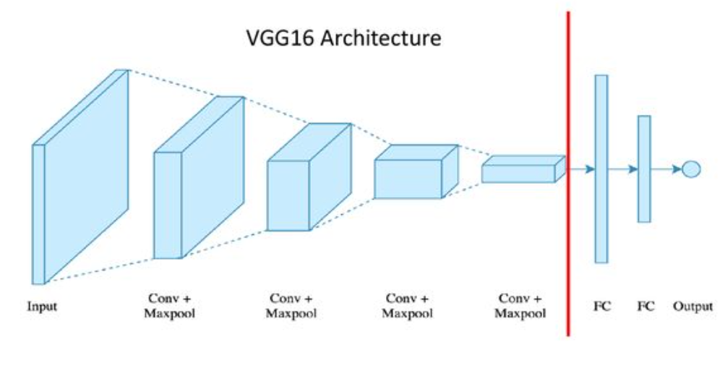
Model Architecture
Total params: 14,847,044
Trainable params: 132,356
Non-trainable params: 14,714,688

Slide 15
Training the model and checking accuracy on validation set
history=model.fit(X_train,Y_train, validation_data=(X_val,Y_val), epochs=10, batch_size=150, verbose=1)

Slide 16
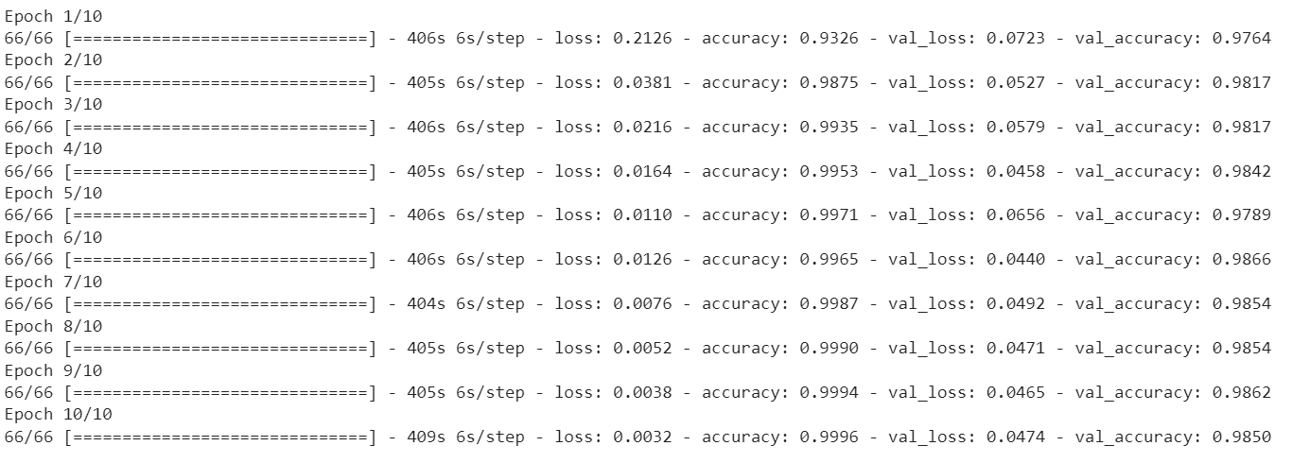
Verbose

Slide 17
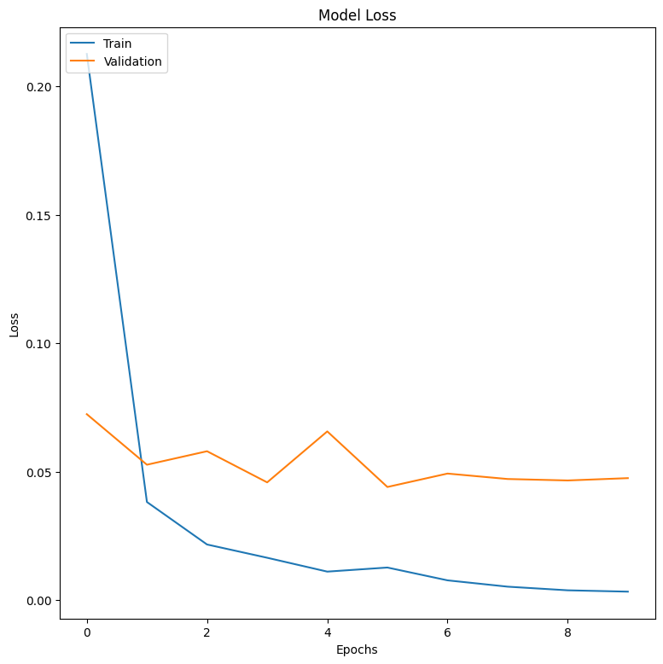
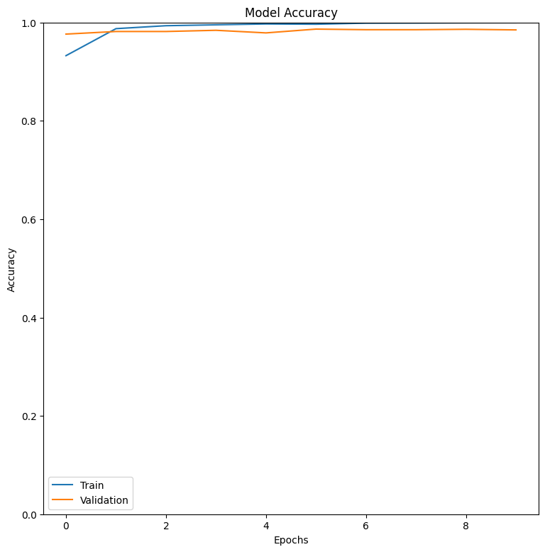
Plotting Loss and Accuracy

Slide 18
Evaluating on unseen test data
# Evaluate the model on the test data
test_loss, test_accuracy = model.evaluate(X_test, Y_test)
print("Test Loss:", test_loss)
print("Test Accuracy:", test_accuracy)
Test Loss: 0.042733583599328995
Test Accuracy: 0.988304078578949

